Slide 1
LIVER DISEASES
Prepared by,
Dr. Panchajani. R

Slide 2
LEARNING OBJECTIVES
Liver function tests
Viral Hepatitis
Autoimmune hepatitis
Primary Biliary Cirrhosis
Primary Sclerosing Cholangitis
Hemochromatosis
Wilsons
Gallstones and cholecystitis
Complications of end stage liver disease
Ascites
SBP
Hepatorenal Syndrome
Encephalopathy

Slide 3
Anatomy
Four lobes
Right, left, quadrate, caudate lobes
Supporting structures
Right & left triangular ligament & falciform ligament.
blood supply- portal vein (80%) & hepatic artery(20%)

Slide 4
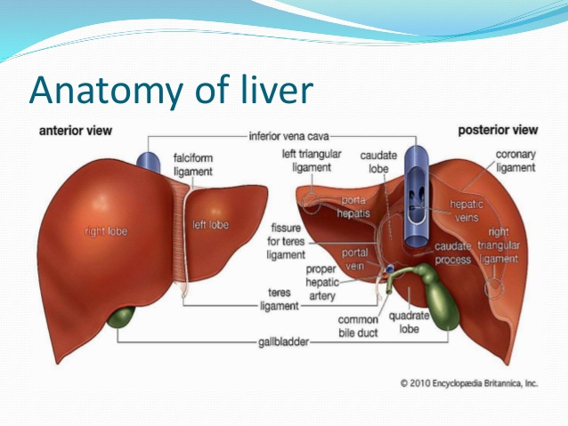

Slide 5
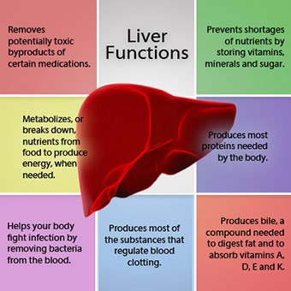

Slide 6
Liver function test
I.
Serum bilirubin -
Serum albumin, globulin, albumin- globulin ratio - indicator of chronic liver disease
Prothrombin time – for cell synthesis
II .Test for serum enzyme assays; For liver injury , liver damage
Alkaline phosphatase – secretory function
AST(SGOT)- inflammation
Alanine transaminase ,ALT(SGPT) – liver specific
5 nucleotide
GGT- 10- 48 IU/L

Slide 7
Liver function test
Immunological test – antimitochondrial or antinuclear antibodies
AFP – for HCC
Specific tests –
for haemchromatosis- serum iron, total iron binding capacity , serum ferritin
wilsons disease- serum copper, urinary copper, serum ceruloplasmin

Slide 8
Liver function test
Fluorodeoxyglucose positron emission tomography scan(FDG-PET) – Inflammatory,benign& malignant liver diseases
Tc 99m labelled radio isotope scan – shows uptake & excretion of bile
Sulphur colloid Liver scan - for kupffer cell activity
Urine for bile salt, bile pigment, urobilinogen

Slide 9
Liver function test
Other investigations
USG
Angiography
CT Scan
PTC
ERCP
MRI
Laparoscopy & laparoscopic US
Liver biopsy

Slide 10
LIVER FUNCTION TESTS
ALT (SGPT) – Alanine aminotransferase
( serum glutamate pyruvate transaminase)
AST (SGOT)-Aspartate aminotransferase(serum glutamate oxaloacetate transaminase )
ALKALINE PHOSPHATASE
BILIRUBIN

Slide 11
ALT and AST
  Enzymes, found in Hepatocytes
  Released when liver cells damaged
  ALT is specific for liver injury
  AST (SGOT) is also found in skeletal and cardiac muscle
  Normal levels AST - 10- 40 IU/L
  ALT- 7-56 IU/L

Slide 12
Transaminitis: < 5 x normal (less than 5 times the upper limit of normal)
AST predominant
  Alcohol-related liver dz
  Steatosis/ Steatohep
  Cirrhosis
Non-hepatic source
  Hemolysis
  Myopathy
  Thyroid disease
  Strenuous exercise
ALT predominant
  Chronic Hep B / C
  Acute A-E, EBV, CMV
  Steatosis / Steatohep
  Hemochromatosis
  Medications / Toxins
  Autoimmune Hepatitis
  Alpha-1-antitrypsin
  Wilson’s Disease
  Celiac Disease

Slide 13
Severe AST & ALT Elev: >15x
Autoimmune Hepatitis
Wilson’s Disease
Acute bile duct obstr
Hepatic Artery ligation
Budd-Chiari Syndrome
Medications / Toxins
  acetaminophen
  CCl4
Acute Viral Hepatitis
  does not predict outcome
  Bili > 20 poor prognosis
Ischemic Hepatitis
  hypotension
  sepsis
  hemorrhage
  MI

Slide 14
ALKALINE PHOSPHATASE
Found in hepatocytes that line the bile canaliculi
Level is raised in Biliary obstruction (causes stretch of the bile canaliculi)
BUT also found in BONE and PLACENTA
GGT is also found in bile canaliculi and therefore can be used in conjunction with Alk Phos for predicting liver origin
BUT GGT can be raised by many drugs including Alcohol and therefore non specific

Slide 15
BILIRUBIN
Water insoluble product of heme metabolism
Taken up by liver and conjugated to become water soluble so it can be excreted in bile and into bowel.
Patient looks Jaundiced if bilirubin >2.5
If patient is vomiting GREEN, then they have bowel obstruction below the level of the Ampulla of Vater.

Slide 16
DIRECT AND INDIRECT BILIRUBIN
Prehepatic disease (eg hemolysis) causes high bilirubin which is non conjugated ie. Indirect fraction higher
Hepatic disease causes increased conjugated and unconjugated bilirubin
Post hepatic disease eg. Gallstones have increased conjugated (direct) bilirubin and lead to dark urine and pale stool.

Slide 17
TESTS OF LIVER FUNCTION
PROTHROMBIN TIME/ INR
ALBUMIN

Slide 18
PROTHROMBIN TIME/INR
Measure of the Vitamin K dependent clotting factors ie. II, VII, IX and X.
The liver is involved in activating Vitamin K. Therefore in liver damage, these clotting factors cannot be produced.
Before you believe that prolonged INR is due to liver disease just make sure the patient has adequate Vitamin K by giving 10mg sc.
Giving Vitamin K has no effect on INR if patient has impaired synthetic function.

Slide 19
ALBUMIN
Albumin has a half life of 21 days, so the drop that occurs with hepatic dysfunction does not occur acutely
That said, acute illness can cause albumin to drop rapidly – a process thought to be due to cytokines increasing the rate of albumin metabolism
HOWEVER, don’t forget that low albumin also occurs in NEPHROTIC syndrome, so always check the urine for protein.

Slide 20
TYPICAL PATTERNS
HEPATOCELLULAR
  Increased transaminases
    Viral Hepatitis
    Drugs/alcohol
    Autoimmune
    NASH
    Hemochromatosis
CHOLESTATIC
  Increased Alk Phos and Bilirubin
  Also may cause increased transaminases
    Gallstones
    Primary Biliary Cirrhosis
    Sclerosing Cholangitis
    Pancreatic C/a

Slide 21
Alcoholic Liver Disease
ETOH - ethyl alcohol
  Steatosis 90- 100%
  hepatitis 10- 35%
  cirrhosis 8- 20%
GGT
AST > ALT
2:1 - 3:1 ratio
AST < 300
Why the discrepancy?
  ETOH ↑AST synthesis
  Vit B6 def inhibits ALT

Slide 22
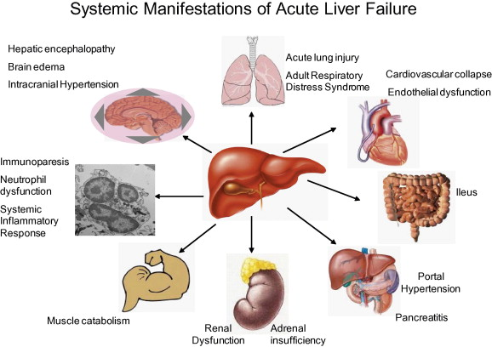

Slide 23
Manifestation of chronic liver diseases
Lethergy& weakness
Jaundice
Fever due to bacterial infection
CVS- Hyperdynamic circulation involving high cardiac output, large pulse volume, low BP, flushed warm extremities.
Skin changes- spider naevi, palmar erythema, white nails.
Endocrine - hypogonadism,gynaecomastia

Slide 24
Chronic liver disease
Neurological- hepatic encephalopathy, memory impairment, confusion, altered sleep pattern, slow slurred speech.
Flapping tremor
Ascites in later stages
Protein catabolism – wasting of muscles
Coagulopathy
Portal hypertension
oesophageal varices
splenomegaly

Slide 25
Stigmata of liver disease
HANDS:
      Palmar Erythema
      Clubbing
      Dupytrens
      Leuconychia
      FLAPPING TREMOR
UPPER BODY
      Jaundice
      Spider Angiomata
      Gynaecomastia and scant body hair
      Scratch marks
ABDOMEN
      Ascites
      Hepatosplenomegally
      Caput Medusa
      Hemorrhoids on PR
      Small testes

Slide 26
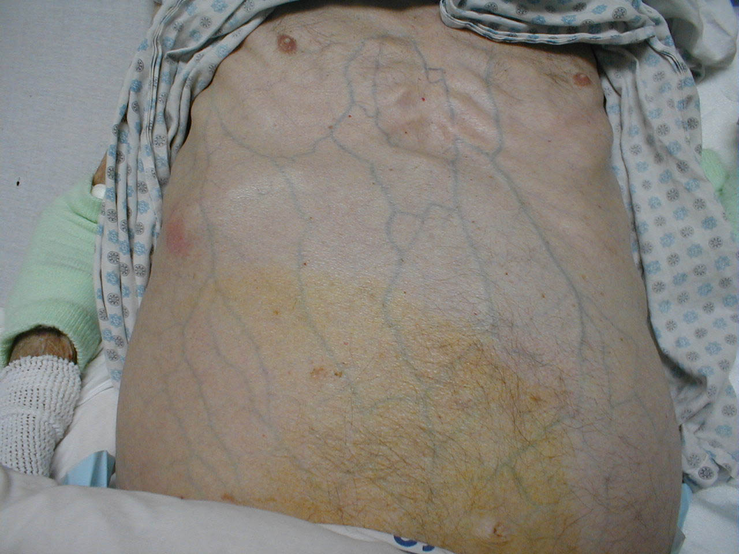
Caput medusa

Slide 27
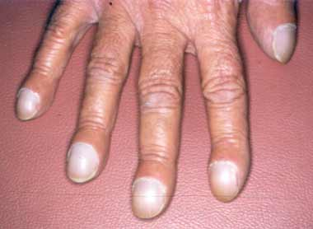
Clubbing

Slide 28
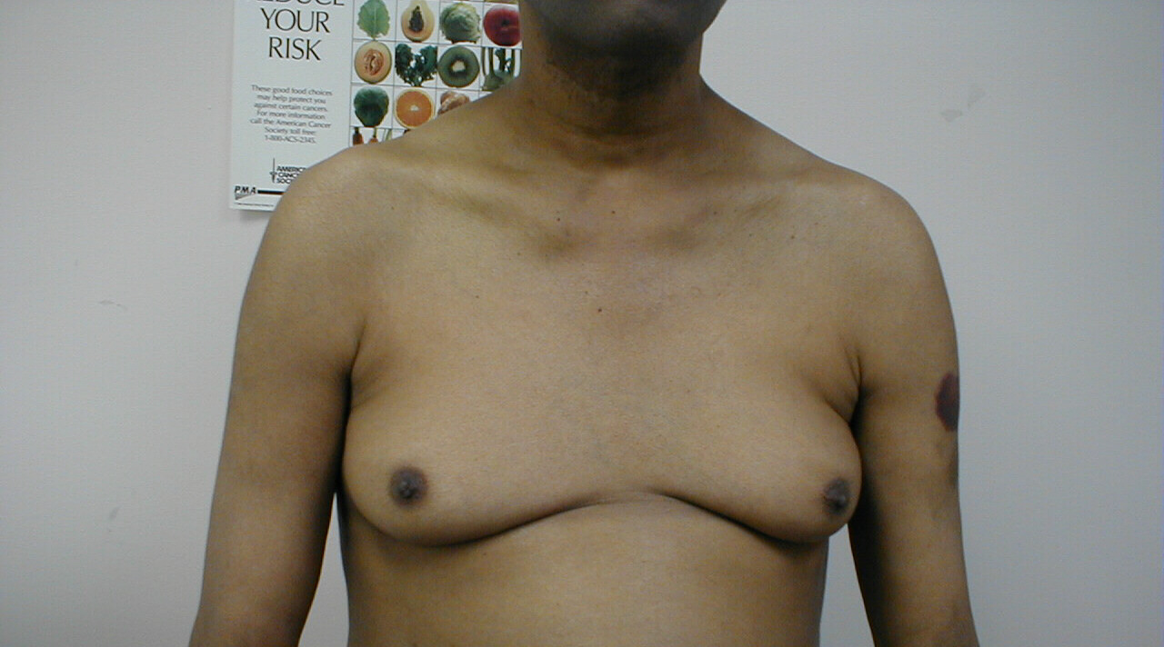
gynaecomastia

Slide 29

Jaundice

Slide 30
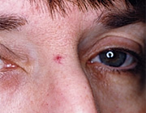
Spider naevi

Slide 31
Liver trauma
Second most common injured organ in abdominal trauma
cause-Blunt injuries & penetrating injuries
Diagnosis - major blood loss
Note associated injuries
CT Scan of chest
Laparoscopy

Slide 32
Liver trauma-Management
Remember associated injuries
Risk groups- stabbing/ gun shot injuries
Lower chest / upper abdominal injuries,
crush injuries with multiple rib fractures
Resuscitate airway, breathing& circulation
Assessment of injury by spiral CT with contrast
Tt.- correct Coagulopathy,
Suture lacerations
resect major vascular injury
packing in diffuse parenchymal injury

Slide 33
Liver trauma- complications
Intrahepatic hematoma
Liver abscess
Bile collection
Biliary fistula
Hepatic aneurysm
Arterio venous fistula
Arterio biliary fistula
Liver failure
Bile duct stricture

Slide 34
Portal hypertension
Portal vein arises from joining the S.V & S.M.V behind the neck of pancreas
It is 5-8cm in length in the extra hepatic course& divides right & left branches
It causes80% of blood supply to liver
Normal portal pressure is 5-10mmof Hg
When it is elevated to 15 mm or more is PH
Detected by trans hepatic portography, liver angiography, umbilical vein catheterisation

Slide 35
Portal hypertension - aetiology
Due to an obstruction which can be
Prehepatic, intrahepatic & post hepatic
Prehepatic –
congenital absence / abnormality in PV
Thrombosis of the PV
Obstruction of PV due to ch. Pancreatitis, Ca pancreas
Isolated splenic vein thrombosis in alcoholic pancreatitis

Slide 36
Portal hypertension - Aetiology
Intrahepatic -

Slide 37
VIRAL HEPATITIS
acute infection has IgM antibodies and chronic has IgG

Slide 38
Viral Hepatitis
HAV
HBV
HCV
HDV
HEV
Incubation
4 weeks
4 – 12 weeks
7 weeks
4 – 12 weeks
6 weeks
Onset
Acute
Acute / insidious
Insidious
Acute / insidious
Acute
Transmission
Fecal – oral
Parenteral +++
Perinatal +++
Sexual ++
+++
variable
+
+++
+
++
Fecal - oral
Clinical
Fulminant
Progression to
chronicity
0.1 %
None
0.1 – 1 %
Neonates 90%
Adults 1-10%
0.1 %
Infect 80-90%
Hepatitis –70%
5 – 20 %
Common
1 – 2%
None
HCCancer
+
+
+
Prophylaxis
Immune globulin
Inactivated vacc
Immune globulin
Recombinan vacc
NONE
HBV vaccine
NONE
Therapy
NONE
IFN
Lamivudine
Interferon
Ribavirin
Interferon +
None

Slide 39
HEPATITIS A
RNA Virus
Fecal-oral
Incubation 15-50 days
Anti -Hepatitis A IgM present during acute illness.
TX/Prevention: Vaccine, Immune serum globulin for contacts
Px: Good – doesn’t become chronic rarely fulminant liver failure.

Slide 40
HEPATITIS B
DNA Virus
Consists of surface and core
Core consists of Core antigen and e-antigen
Most infections are subclinical, but can present with arthralgias, glomerulonephritis, urticaria
Parenteral or sexual transmission.

Slide 41
Hepatitis B continued
Hepatocellular necrosis occurs due to the body’s reaction to the virus rather than due to the virus itself
Therefore patients who have a severe illness from hep B are more likely to clear the virus.
SEROLOGY:
  Remember Acute infection has IgM chronic has IgG
  Anti Core IgM is present during acute phase
  Anti Core IgG indicates chronic infection.
  Patients with Hep B e Ag have continued active replication
  Immunized or previously exposed people have Negative HBsAg and HBeAg, they have IgG Anti HB Core, and Positive anti Hep Bs and e.

Slide 43
Serological Patterns of Acute & Chronic Hepatitis B

Slide 46
Hepatitis C
RNA virus
Blood bourne ie. Transmission from IV drug use and transfusion of blood products prior to 1990.
Can also be transmitted by snorting cocaine.
Sexual transmission is low.
Testing involves Anti HCV Antibody, and then viral load if positive.
85% of patients develop chronic infection.

Slide 47
Complications of Hep C
Cirrhosis
Hepatocellular carcinoma
Cryoglobulinaemia
Prophyria cutanea tarda

Slide 48
Management of Hep C
Interferon alpha with ribavirin for 6 to 12 months clears virus in approx 40% of patients.
There is an algorithm which is used to decide who is treated, but basically anyone with Hep C, high ALT and less than 40 yo. If older than 40 should have biopsy first which should at least show periportal inflammation or fibrosis.

Slide 49
Other issues re. Hep C
Once pt with Hep C is cirrhotic their risk of developing hepatocellular Ca is 1-4% per year
Alcohol increases risk

Slide 50
Other viral hepatitis
Hep E: Acute hepatitis just like hep A unless you are PREGNANT in which case can progress to fulminant hepatitis
EBV, CMV, Herpes viruses can all cause acute hepatitis especially in immunocompromised.

Slide 51
Question
A 38 yo woman was found to be Hep C positive 6 months ago after evaluation for raised AST. The infection was attributed to blood transfusions received during a car accident 15 years ago. She was pleased to learn last month that she is pregnant with her first child.
The physical examination is within normal limits
She would like further information concerning her prognosis and the risk of transmission of HCV to her husband and her child.
All of the following statements about HCV infection are true except:
The chance of transmission of HCV to the newborn is low in the 5% range.
Barrier precautions including safe sex are recommended for all couples in a monogamous relationship because of high risk of transmission to the partner
Low level transmission of Hep C is recognized within households (5-10%), and the risk for such transmission should be minimized by practices that avoid blood-blood exposure such as sharing dental implements and razors
In patients with Hep C the chance of developing cirrhosis over several decades is 20-35%

Slide 52
Answer B
Maternal-fetal HCV transmission is approx 5%, however if mother is co-infected with HIV then risk increases to 30%
Risk of sexual transmission between monogamous spouses is also low approx 5%
Transmission can occur between non-sexual household contacts therefore should be told to avoid sharing razors etc.
20-35% of patients with Hep C develop cirrhosis

Slide 53
Three “autoimmune” liver diseases
They are easily confused:
  Autoimmune hepatitis
  Primary Biliary Cirrhosis
  Primary Sclerosing Cholangitis

Slide 54
AUTOIMMUNE HEPATITIS
ANA positive
Anti smooth muscle positive
High bilirubin and ALT but normal Alk Phos (cf. Primary biliary cirrhosis)
Presentation: tiredness, anorexia, RUQ pain, cushingoid facies despite no exogenous steroids. Stigmata of liver disease
Pathology: Piecemeal necrosis with lymphocyte infiltration
Tx: immunosupression, liver transplant
Complications: All the complications of chronic liver disease

Slide 55
Primary Biliary Cirrhosis
Increased Alk phos and Antimitochondrial positive
Damage to intralobular bile ducts by chronic granulomatous inflammation
Associated with other autoimmune diseases (Thyroid, RA, Sjogrens, Systemic Sclerosis)
NB. See granulomas on Bx not piecemeal necrosis
Unable to excrete bile, therefore present with malabsorption of fat soluble vitamins. And with evidence of portal hypertension.
Present with lethargy, itching and increased Alk Phos in a middleaged woman.
May have hyperlipidaemia
Consider in any patient with autoimmune disease presenting with liver disease.

Slide 56
Primary Sclerosing Cholangitis
Seen in patients with UC and HIV
Inflammation, fibrosis and strictures of biliary tree causing “Beaded biliary tree” on ERCP
Chronic biliary obstruction leads to cirrhosis
Presentation: Asymptomatic high Alk Phos, Jaundice, pruritis abdo pain and fatigue
Dx: High bilirubin and Alk phos but NEGATIVE antimitochondrial Ab (Cf. primary biliary cirrhosis)
Mgt: Steroids, Cholestyramine or ursodeoxycholic acid to treat the pruritis and cholestasis but does not affect disease process
Liver transplant for endstage disease but 20% recur.
NB. PSC is independent of activity of UC.

Slide 57
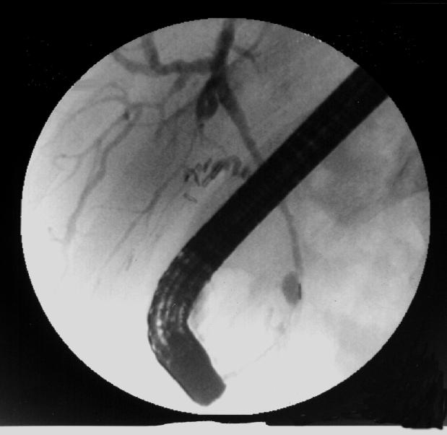
What does this ERCP show?

Slide 58
NASH
Non-Alcoholic Steatohepatitis
Common cause of elevated liver function tests
Often patients have metabolic syndrome with obesity, hyperlipidemia and diabetes
20-30% progress to cirrhosis
Weight loss, control of lipids and diabetes should reduce progression.

Slide 59
Genetic Liver disease
Wilsons
Hemochromatosis
Alpha-1-Antitrypsin deficiency

Slide 60
Hemochromatosis
Autosomal recessive
Gene on Chromosome 6
Increased Fe absorption from gut, depositied in tissues causing fibrosis and functional failure.
Presentation: “BRONZE DIABETES”, but also arthralgias, Hepatosplenomegally and stigmata of liver disease, testicular atrophy, CCF due to restrictive cardiomyopathy
Dx: High Fe and Ferritin, low TIBC, Low testosterone, Diabetic. Joint XRays show chondrocalcinosis
Dual energy CT scan shows iron overload
Liver Bx shows Fe staining
NB. Hemochromatosis can be secondary to B Thalassemia and repeated blood transfusions.

Slide 61
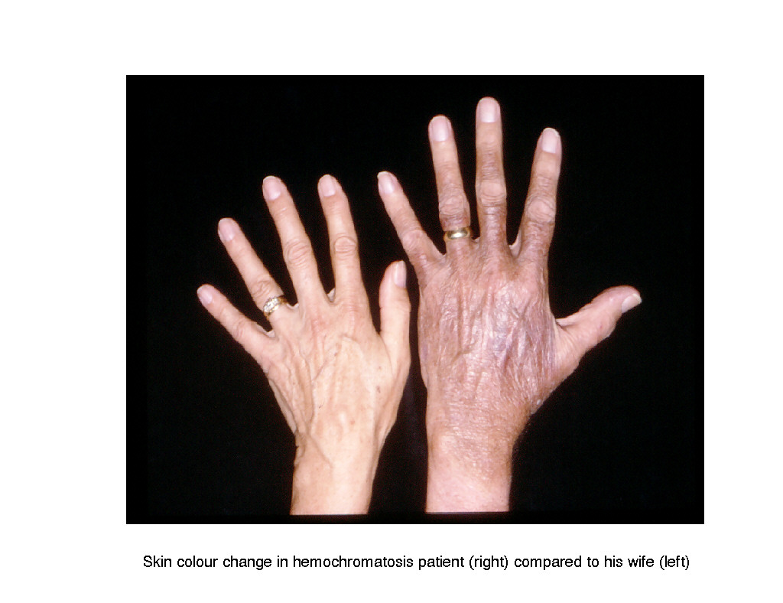
Skin color of Hemochromatosis

Slide 62
QUESTION
During evaluation of an elevated ALT a 45 year old alcoholic man is found to have a serum iron concentration of 245mg/dL, a total iron binding capacity of 290 mg/dL 84% transferrin saturation and a serum ferritin of 2120ng/mL. The physical examination shows no evidence of chronic liver or cardiac disease
Which one of the following is the most appropriate course of management for this patient?
Biopsy to make a definitive diagnosis
MRI evaluation for iron overload
Weekly phlebotomy
HLA typing

Slide 63
Answer A
Definitive diagnosis of Hemochromatosis requires liver biopsy to determine hepatic iron index.
If positive the patients siblings should be screened

Slide 64
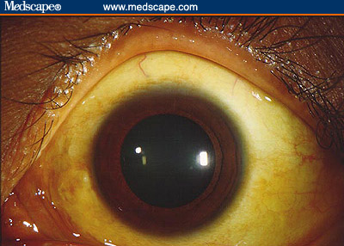
What is this sign called and what is it associated with ?

Slide 65
Wilson’s Disease
Autosomal Recessive
Deletion on Chromosome 13
Defective intrahepatic formation of caeruloplasmin therefore failure of biliary excretion and high total body and tissue levels of copper.
Dx High serum caeruloplasmin, increased urinary copper.
PRESENTATION: Cirrhosis, Kaiser-Fleischer rings, hypoparathyroidism, arthropathy, Fanconi syndrome (renal tubular acidosis) CNS: Psychosis, extrapyramidal syndrome, mental retardation and seizures.
Think of this in a young patient with strange neurology and liver disease
Tx: Copper chelation with penicillamine, can cure with liver transplant BUT the CNS sequalae will not resolve.

Slide 66
α-1 Antitrypsin Deficiency
THE AUTOSOMAL DOMINANT ONE!
Severity of disease is dependent on which alleles are affected (ie which phenotype)
Gene on Chromosome 14
Intrahepatic accumulation of α-1 Antitrypsin causes liver disease and can lead to cirrhosis
May have Lung disease (emphysema)

Slide 67
Budd Chiari Syndrome
Just know that it is thrombosis of hepatic veins
May be acute or chronic
May be associated with hypercoagulable state therefore must do thrombophilia screen. Also look for underlying maliganacy
Can occur with hydatid cysts
Presentation: Nausea, Vomiting, Abdo pain, Tender hepatomegally and loss of hepatojugular reflex
Tx: call a hepatologist: may need TIPPS or may need portocaval or splenorenal anastomosis. May be thrombolysable. Always call for help.

Slide 68
Hepatocellular Carcinoma
Risk factors: Hep B and C, Cirrhosis of any cause, Exposure to Aspergillus Flavus toxin
Screening – Alphafetoprotein should be checked annually in patients with cirrhosis. Need USS if high
Less than 15% are resectable at diagnosis.

Slide 69
To understand gallstones
You first need to know the anatomy of the biliary tree

Slide 70
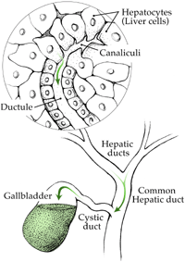

Slide 71
Complications of gallstones
In the gall bladder:
        biliary colic
        Acute and chronic cholecystitis
        Empyema, mucocele
        Carcinoma
In the bile ducts
        Obstructive Jaundice
        Pancreatitis
        Cholangitis
In the Gut
        Gallstone ileus

Slide 72
Acute Cholecystitis
Stone impacting in neck of gallbladder
Continuous RUQ pain, vomiting, fever, MURPHYS SIGN Positive
USS: Thickened gall bladder wall
HIDA scan: Blocked cystic duct
Tx NPO, IV Abx, analgesia
Needs cholecystectomy either within 48 hours or wait 3 months

Slide 73
Chronic Cholecystitis
Vague abdominal pain, flatulence, fat intolerance
Fair fat fertile females of forty
USS and ERCP reveal stones. May need sphincterotomy

Slide 74
Biliary colic
RUQ pain radiating to back
Tx analgesia and cholecystectomy

Slide 75
Cholangitis
RUQ pain, rigors and Jaundice.
Needs IV Abx

Slide 76
Gallstone ileus
So rare there is hardly any point mentioning it
Stone perforates Gallbladder into duodenum passes through bowel and obstructs terminal ileum.
Abdo XR diagnositic: Air in CBD with small bowel obstruction

Slide 77
ERCP
Indications
  Jaundice with dilated ducts on USS
  Recurrent pancreatitis
  Post cholecystectomy pain (check for retained stone)
Complications
    Acute pancreatitis
    Bleeding
    Infection – cholangitis
    Perforation
Procedure
    Sideviewing endoscope used to insert catheter into CBD and inject contrast. XRay screening will then show up lesions in biliary tree
Your job ie. what prep does my patient need
    NPO for 12 hours
    Check clotting and plt count
    Prophylactic antibiotics as per endoscopy department protocol

Slide 85
Cirrhosis
4 Stages
    Liver cell necrosis
    Inflammatory cell infiltate
    Fibrosis
    Nodular regeneration which may be macronodular (alcohol), micronodular (viral) or mixed

Slide 86
CAUSES OF CIRRHOSIS
Alcohol
Viral B/C
Cryptogenic
Primary Biliary Cirrhosis
Hemochromatosis
Wilsons
Alpha 1 antitrypsin deficiency
Autoimmune
Sclerosing Cholangitis

Slide 87
COMPLICATIONS
Portal Hypertension causing variceal bleed
Splenomegally causing low platelets
Ascites
Encephalopathy
SBP
Hepatorenal syndrome

Slide 88
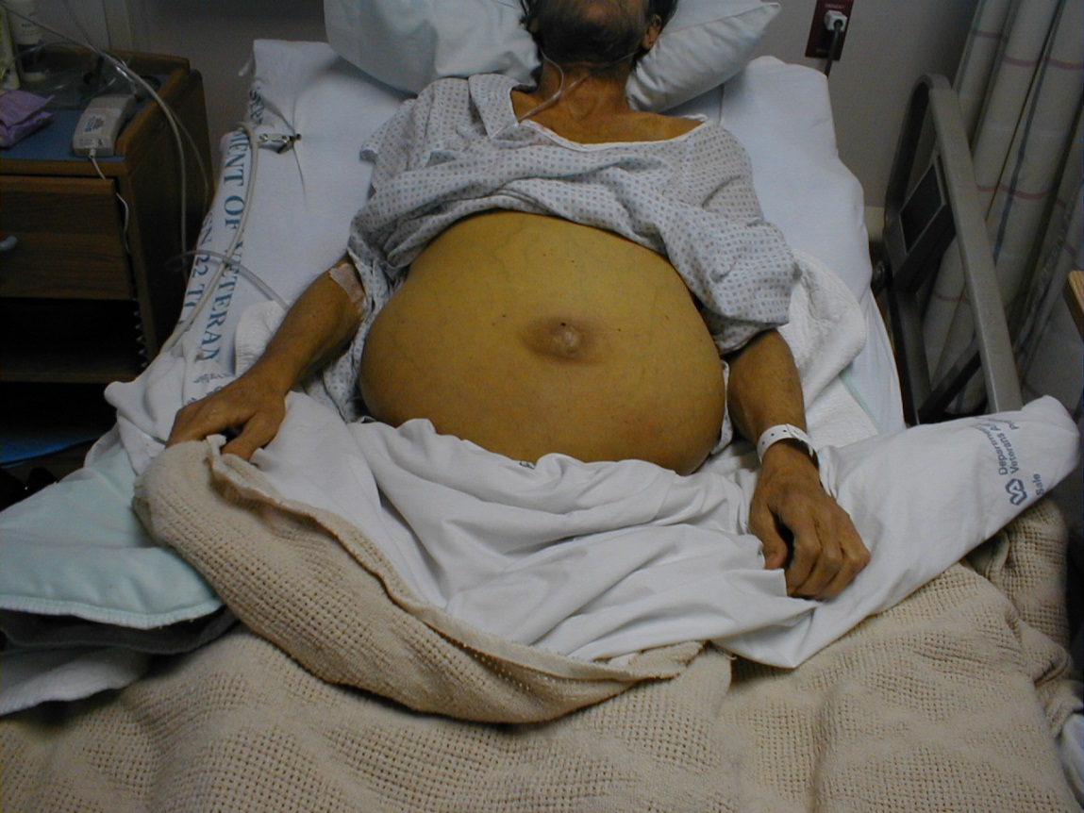
Demonstrate the examination necessary to identify the cause of abdominal distension

Slide 89
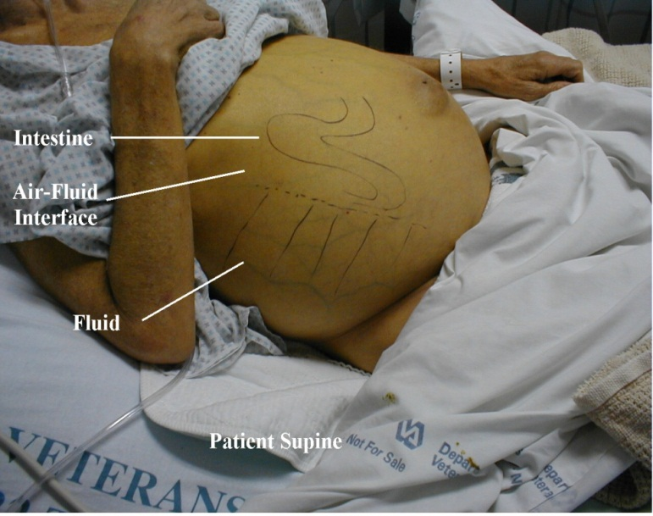


Slide 90
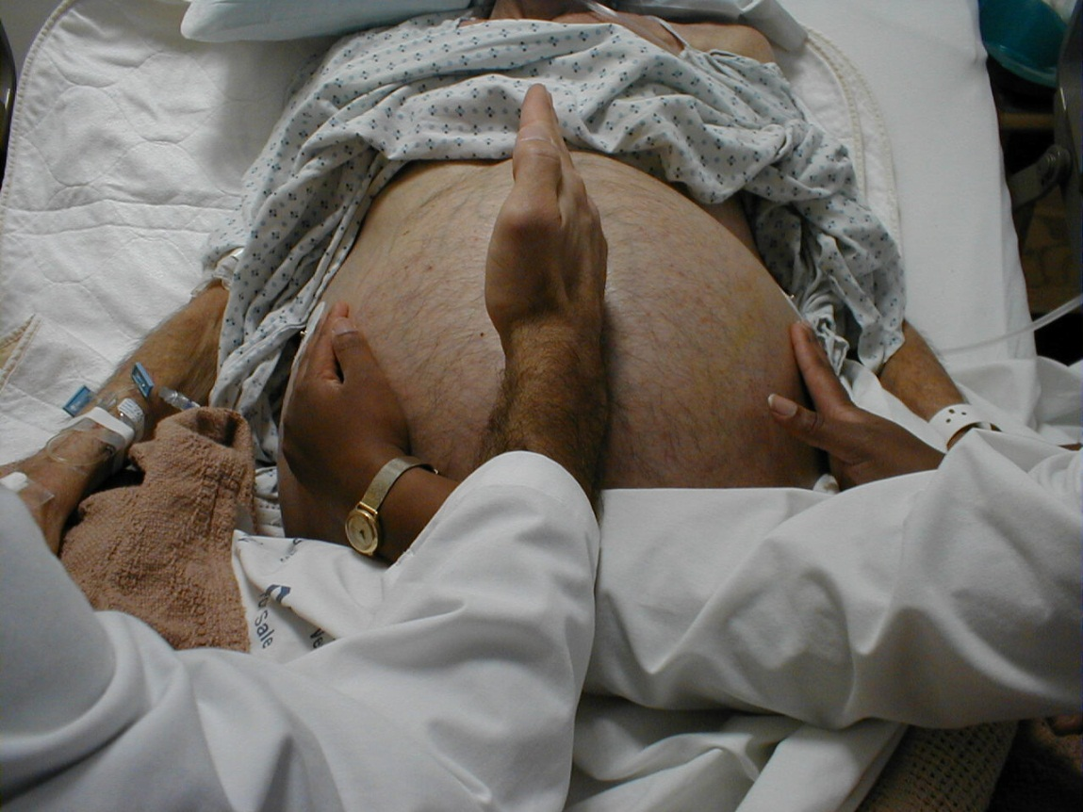

Slide 91
Ascites
Accumulation of free fluid in peritoneum
Assessment involves taking sample of fluid and checking albumin content
SAAG: Serum Ascites Albumin Gradient
  SAAG = Serum Albumin – Ascites Albumin

Slide 92
SAAG
HIGH ie. ≥1.1
Portal hypertension present
  Cirrhosis
  Alcoholic hepatitis
  Congestive cardiac failure
  Hepatic mets
LOW ie <1.1
Inflammatory causes
  Peritoneal carcinomatosis
  Peritoneal TB
  Pancreatitis
  Serositis

Slide 93
Management of Ascites
Salt Restrict
Fluid Restrict
Diuretics
  Spironolactone 100-200mg /day to increase urinary sodium excretion. Aim to reduce weight by 1Kg per day
  May also need Lasix
Large volume paracentesis
  Should give 6g Salt poor Albumin per liter of Ascitic fluid removed in patients with HIGH SAAG otherwise can cause precipitous fall in BP and Hepatorenal syndrome.

Slide 94
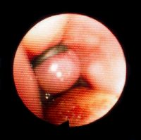
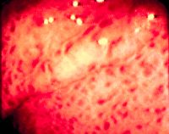
Varices and portal gastropathy

Slide 95
Variceal Hemorrhage
Varices develop at Esophagogastric junction due to portal hypertension
First bleed has 10-30% mortality
Early endoscopy band ligation
Octreotide decreases the portal pressure and may stop the bleeding
80% rebleed within 2 years
Bblockers esp Propranolol reduce portal pressure and may prevent rebleeding
Serial endoscopy and banding to obliterate the varices is also indicated to prevent rebleeding

Slide 96
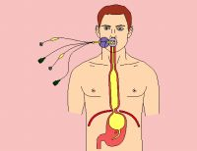

Slide 97
Spontaneous Bacterial Peritonitis
Occurs in 10-20% of cirrhotic patients with ascites
Cell count and culture of ascitic fluid should be performed in all patients
PMN cells >250 is criteria for diagnosis

Slide 98
Hepatorenal syndrome
Renal failure with normal tubular function in patient with portal hypertension.
May be ppted by aggressive diuresis.
Low urine sodium (but so does pre-renal)
No casts in urine
Renal function returns to normal after transplant.

Slide 99
Encephalopathy
Decreased consciousness in patient with severe liver disease
Always look for cause
    Infection
    Bleeding
    Electrolyte disturbance
    Constipation
    Increased protein intake
Usually has increased serum ammonia – which you should check, although, it doesn’t need to be that high for pt to be encephalopathic
Tx: Lactulose

Slide 100
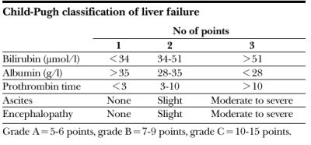
Childs-Pugh classification
Don’t learn this, just know the name and the principle.
It is a scoring system used to assess how risky surgery will be in pts with liver disease
Meld scores and Mayo scores used to assess pts for liver transplant and transplant allocation

Slide 101
LEARNING OBJECTIVES
Liver function tests
Viral Hepatitis
Autoimmune hepatitis
Primary Biliary Cirrhosis
Primary Sclerosing Cholangitis
Hemochromatosis
Wilsons
Gallstones and cholecystitis
Complications of end stage liver disease
Ascites
SBP
Hepatorenal Syndrome
Encephalopathy

